Slide 1

U.S. Prison Sentencing
By: Nick Wagner

Slide 2
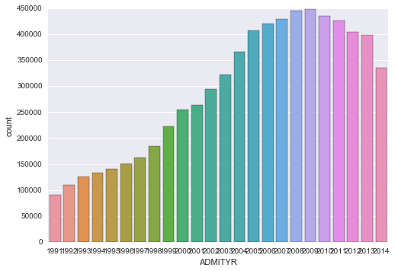
TOTAL SENTENCES (excluding parole violations)
1991 - 2014
** No data for Idaho, Arkansas,
Louisiana, Hawaii, Virginia,
Connecticut & Vermont.

Slide 3
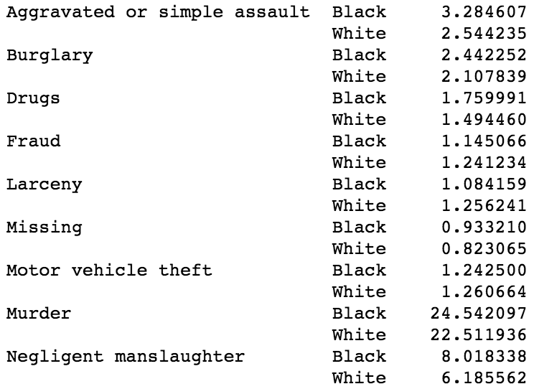
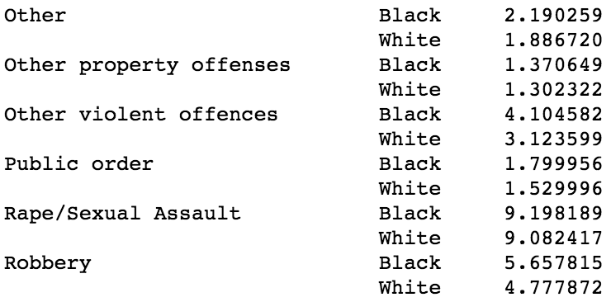
No surprise:
black inmates, on average, are given longer prison sentences.

Slide 4
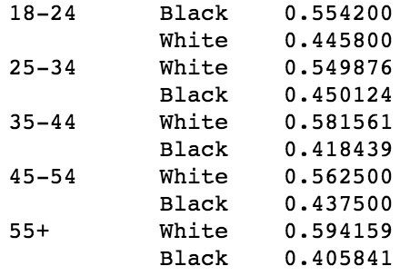
AT ALL AGES, ARE BLACKS AND WHITES SENTENCED IN EQUAL PROPORTION?
The youngest inmates (18-24) are more likely to be black than white.
After 25, whites are sentenced more frequently.

Slide 5
INEQUALITY AFTER RELEASE?
Among white convicts, 36 of every 100 prison sentences are for parole violations.
Among black convicts, 39 of every 100 prison sentences are for parole violations.
Among hispanic convicts, 49 of every 100 prison sentences are for parole violations.

Slide 6
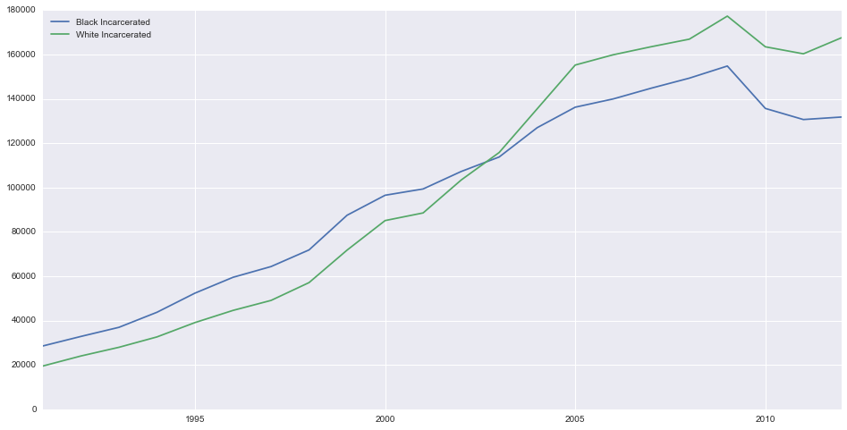
SENTENCES PER YEAR

Slide 7
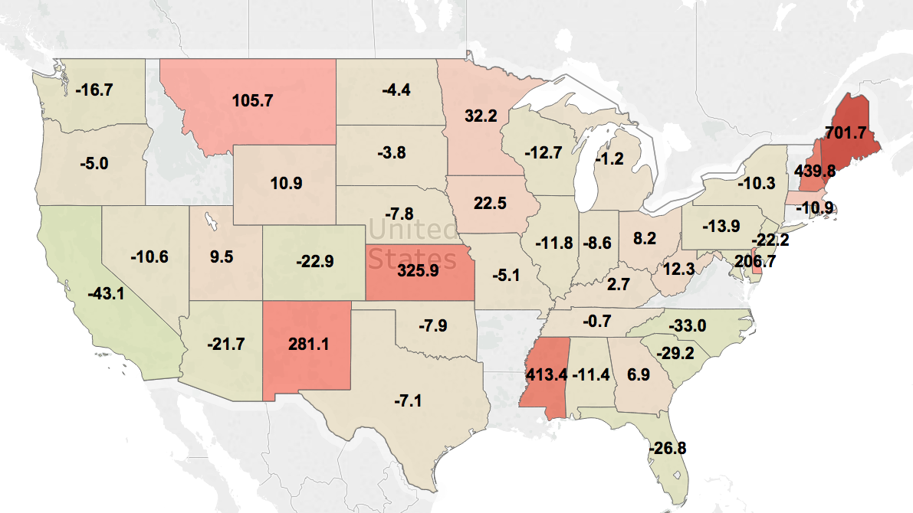
CHANGE IN SENTENCING RATES (2008 - 2012)

Slide 8
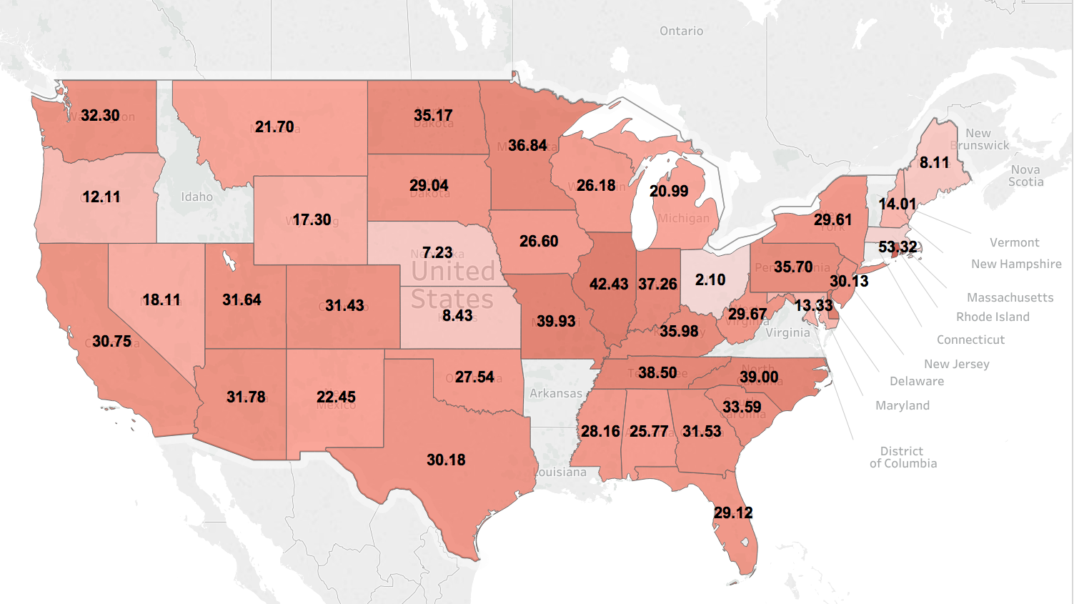
% OF CRIMES COMMITTED BY REPEAT OFFENDERS (2008-2012)

Slide 9
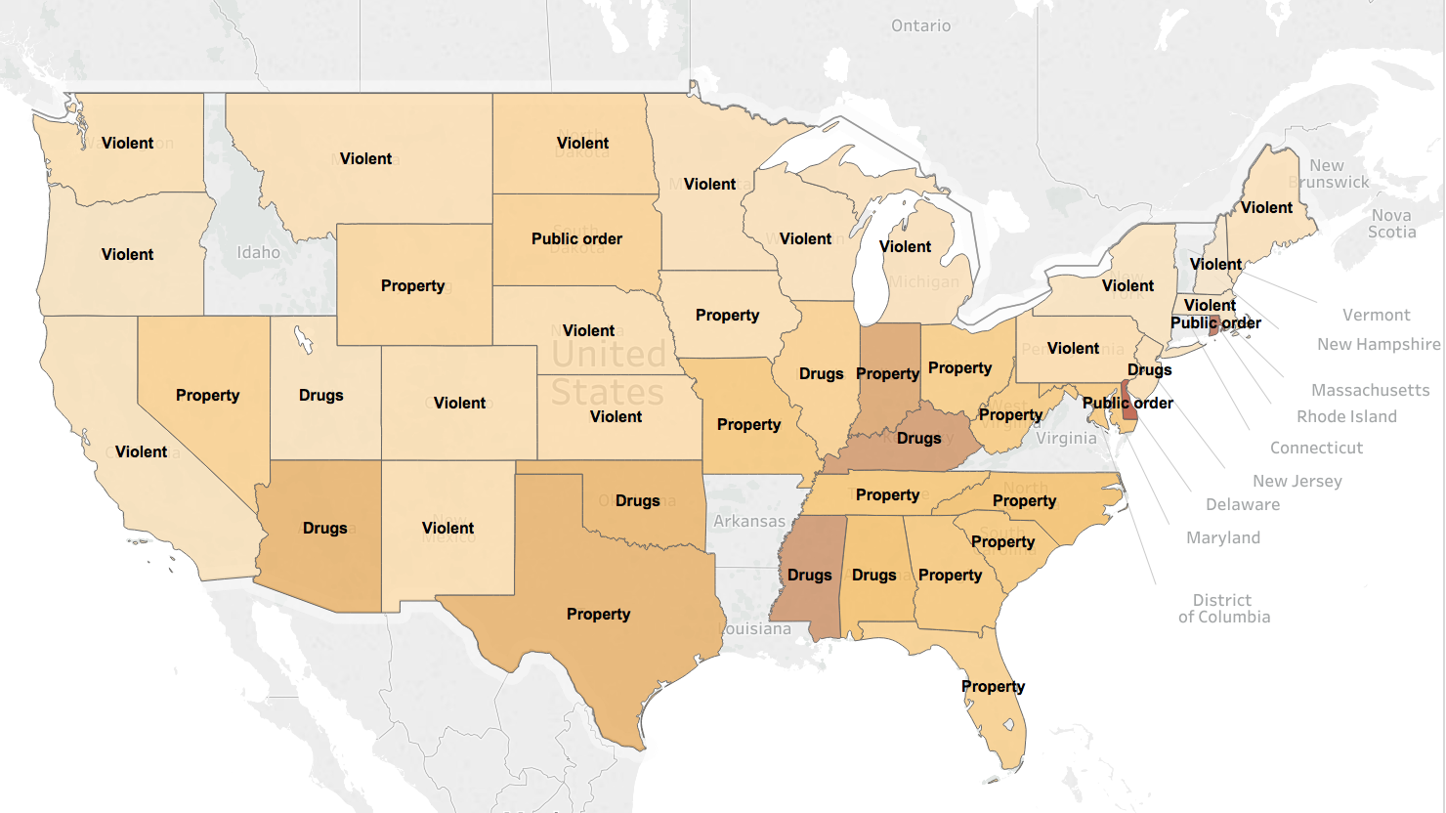
MOST FREQUENTLY SENTENCED CRIME (2008-2012)
* the darker the shade, the greater the
per-capita sentencing rate.

Slide 10
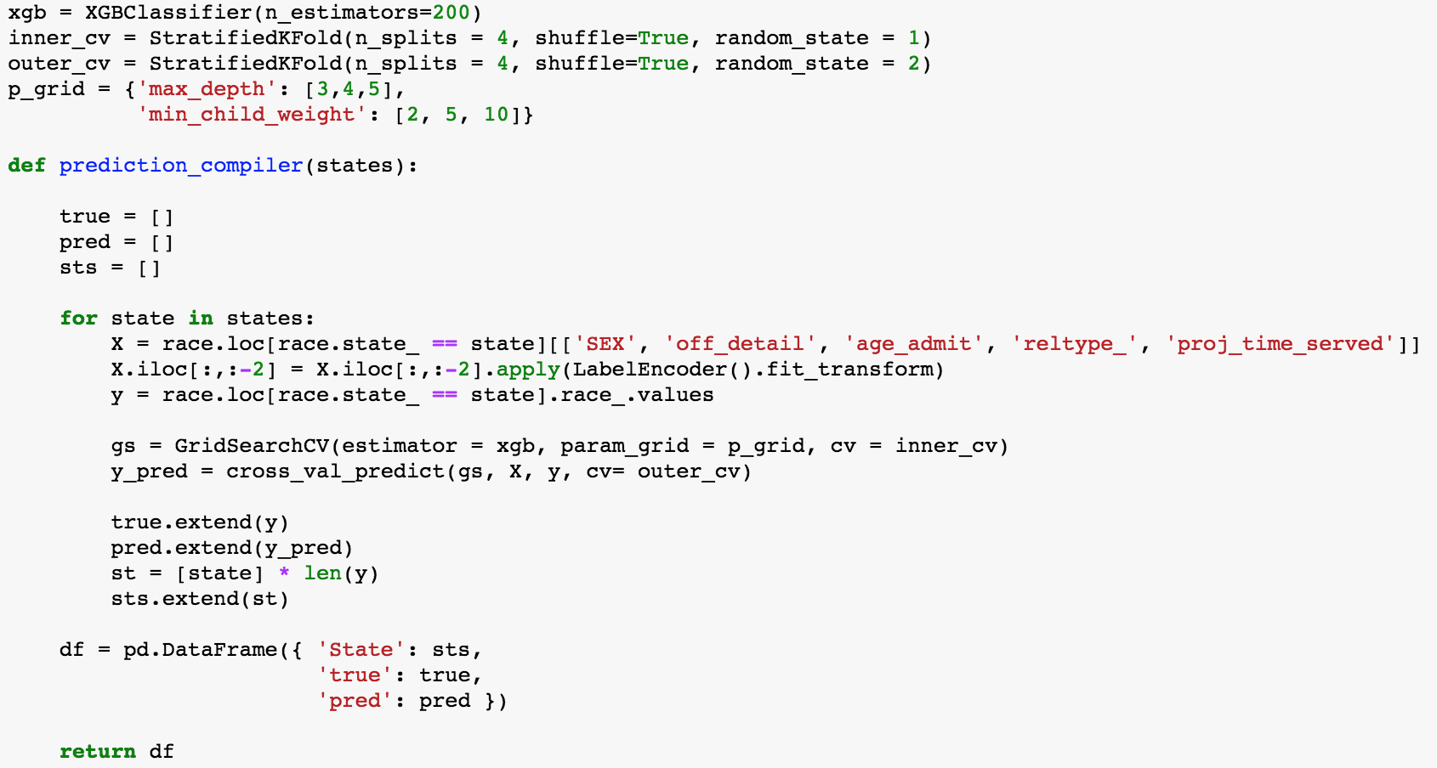
5 HOURS!!

Slide 11

creator of XGBoost
college roommate!

Slide 12
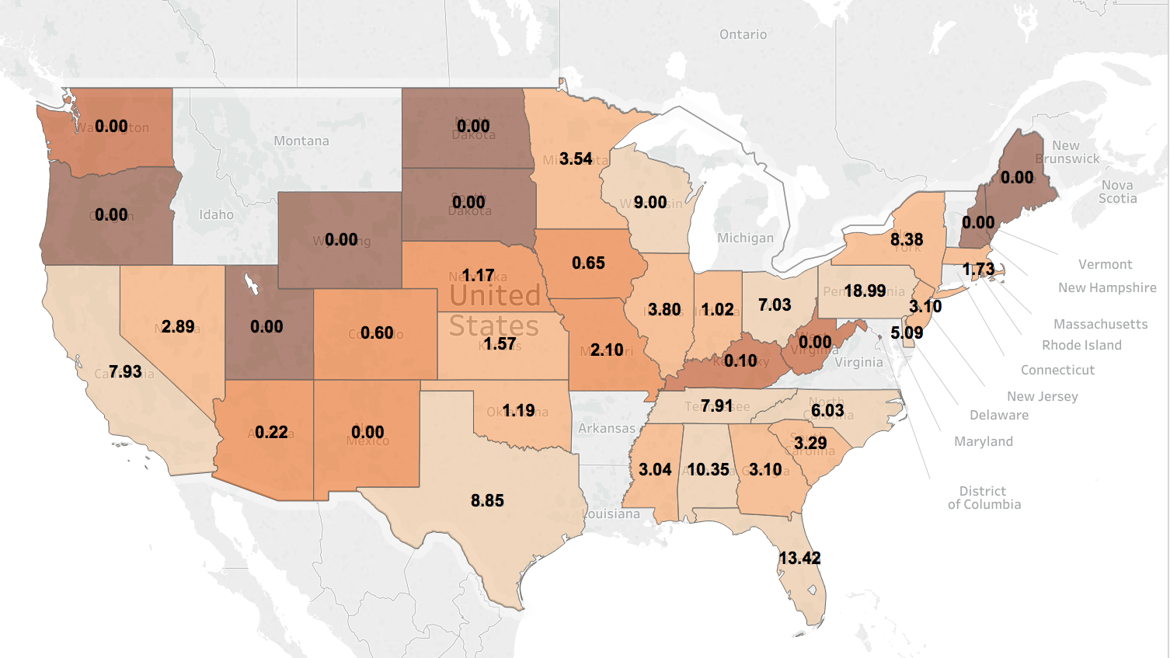
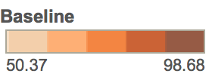
PREDICTING RACE: ACCURACY ABOVE BASELINE

Slide 13
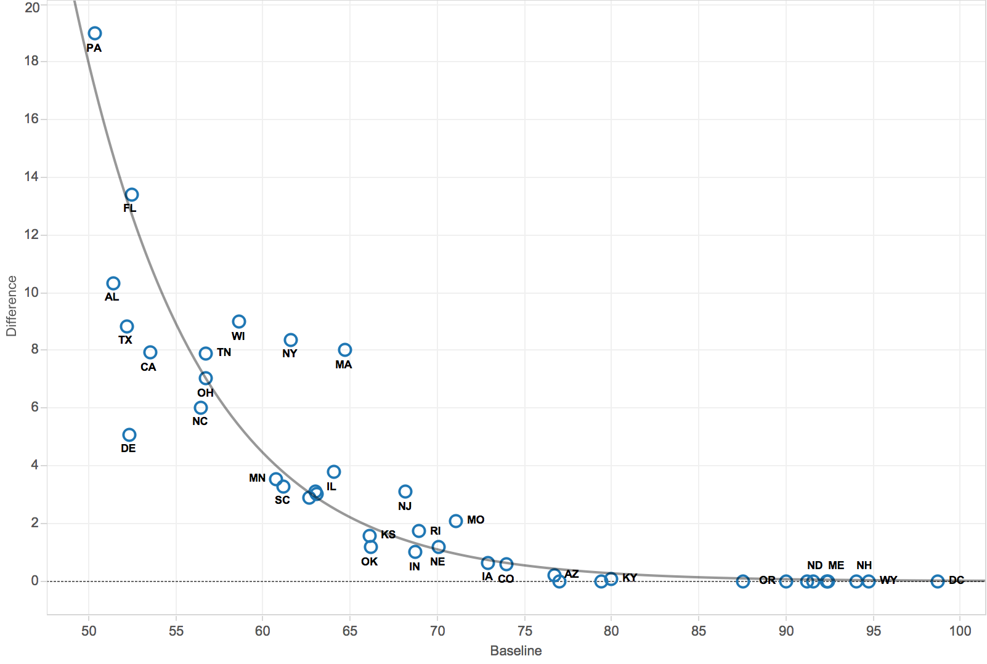
BETTER TO BE LEFT OF/UNDER THE CURVE

Slide 14
RESOURCES:
Bureau of Justice Statistics sentencing data: http://www.icpsr.umich.edu/icpsrweb/NACJD/studies?fundingAgency=United+States+Department+of+Justice.+Office+of+Justice+Programs.+Bureau+of+Justice+Statistics&dataFormat%5B0%5D=Delimited&q=&sortBy=5&paging.startRow=1
2012 population data:
https://www.census.gov/popest/data/state/totals/2012/
2008 population data: https://www.census.gov/popest/data/historical/2000s/vintage_2008/state.html

